Slide 1
Multiple Linear Regression

Slide 2
LINEAR ASSUMPTION
Most statistical tests rely upon certain assumptions about the variables used in the analysis.
When these assumptions are not met the results may not be trust worthy. Here we will discuss the assumptions of
Linearity,
Reliability of measurement,
Homoscedasticity,
Normality.
Multicollinearity

Slide 3
1.LINEARITY
This assumption implies that there should be linear relationship between the response variables and the predictors.
How to diagnose: nonlinearity is usually most evident in a plot of observed versus predicted values or a plot of residuals versus predicted values

Slide 4
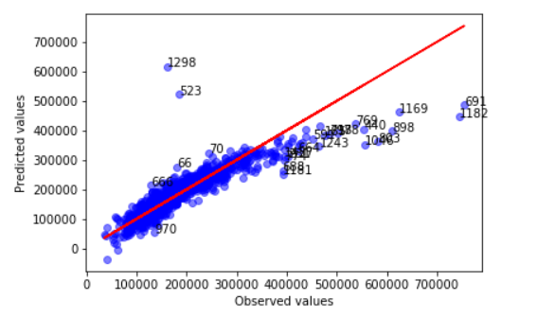
LINEARITY
observed versus predicted values : For a linearly related independent and dependent variables, The points should be symmetrically distributed around a diagonal line.

Slide 5
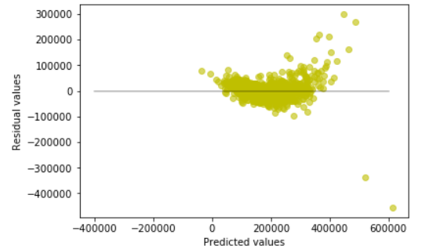
RESIDUALS VERSUS PREDICTED VALUES:
If we speak as a layman, the errors (or residuals) should be close to zero (negative or positive) for any predicted value. That said the dots should be close to horizontal line.

Slide 6
HOW TO FIX NON-LINEARITY
How to Fix: To overcome the issue of non-linearity, you can do a non linear transformation of predictors such as log (X), √X or X² transform the dependent variable.

Slide 7
HETEROSKEDASTICITY
The presence of non-constant variance in the error terms results in heteroskedasticity.
Generally, non-constant variance arises in presence of outliers or extreme leverage values.
How to check: You can look at residual vs predicted (or fitted) values plot.
If heteroskedasticity exists, the plot would exhibit a funnel shape pattern (example shown below). Also, you can use Breusch-Pagan / Cook – Weisberg test or White general test to detect this phenomenon

Slide 8
systematic patterns in residuals versus predicted values and meaning
How to Fix:
To overcome heteroskedasticity, a possible way is to transform the response variable such as log(Y) or √Y. Also, you can use weighted least square method to tackle heteroskedasticity

Slide 9
Q-Q PLOTS
If the distribution is normal, the points on QQ plot should "fall close to the diagonal reference line“
A "bow-shaped pattern" of deviations from the diagonal indicates that the residuals have excessive skewness (i.e., they are not symmetrically distributed, with too many large errors in one direction)
An "S-shaped pattern" of deviations indicates that the residuals have excessive kurtosis (i.e., there are either too many or two few large errors in both directions.)
Sometimes the problem is revealed to be that there are a few data points on one or both ends that deviate significantly from the reference line ("outliers"), in which case they should get close attention.

Slide 10
SERIAL CORRELATION OR AUTO CORRELATIOIN
Potentially very serious in time series regression models. The correlation between consecutive errors or errors separated by some other number of periods is known as "Serial correlation". Serial correlation is sometimes a by product of a violation of the linearity assumption.
How to Check: Look for Durbin – Watson (DW) statistic. It must lie between 0 and 4. If DW = 2, implies no autocorrelation, 0 < DW < 2 implies positive autocorrelation while 2 < DW < 4 indicates negative autocorrelation. Also, you can see residual vs time plot and look for the seasonal or correlated pattern in residual values.
How to Fix: Serial correlation could be due to a violation of the linearity assumption

Slide 11
MULTICOLLINEARITY
Collinearity - Collinearity refers to the situation in which two or more predictor variables are closely related to one another. This will create problems in finding out individual predictor's effect on the restonse variable.
Multicollinearity - Co linearity can be detected by using correlation matrix. The co linearity may exist between three or more predictors even if no pair of predictors has a particularly high correlation. This situation is called Multicollinearity.
How to check: You can use heatmap /scatter plot to visualize correlation effect among variables. Also, we can use VIF (Variance Inflation Factor).
VIF value <= 4 suggests no multicollinearity whereas a value of >= 10 implies serious multicollinearity. Above all, a correlation table should also solve the purpose.
How to fix: We can deal with this issue using regularization concept, which will be delt in coming sessions

Slide 12
Thank You

